Slide 1
Lesson 4 – Generics. Collections Framework: List

Slide 2
Lesson goals
Reuse code via Generics
Use built-in containers: List

Slide 3
Before generics
class KfcBucket { private Object content; Object open() { return content; } void pack(Object content) { this.content = content; } }

Slide 4
Before generics
KfcBucket bucket = new KfcBucket(); bucket.pack(new Nuggets());
pigeon.eatPotato((Potato) box.open()); // runtime error

Slide 5
Generics
class KfcBucket<T> { private T content; T open() { return content; } void pack(T content) { this.content = content; } }

Slide 6
Generics
KfcBucket<Potato> bucket = new KfcBucket<>();
bucket.pack(new Potato()); bucket.pack(new Nuggets()); // compilation error pigeon.eatPotato(bucket.open()); // unreachable code

Slide 7
Generics
KfcBucket<Potato> potatoBucket = new KfcBucket<>(); potatoBucket.pack(new Potato()); pigeon.eatPotato(potatoBucket.open());
KfcBucket<Nuggets> nuggetsBucket = new KfcBucket<>(); nuggetsBucket.pack(new Nuggets()); cat.eatNuggets(nuggetsBucket.open());

Slide 8
Generics evolution
KfcBucket potatoBucketSinceJava1 = new KfcBucket(); KfcBucket<Potato> potatoBucketSinceJava5 = new KfcBucket<Potato>(); KfcBucket<Potato> potatoBucketSinceJava7 = new KfcBucket<>(); var potatoBucketSinceJava10 = new KfcBucket<Potato>();

Slide 9
Generics usage multiple parameter
class KfcMegaBucket<T, U, V> { private T content1; private U content2; private V content3; void pack(T content1, U content2, V content3) { // ... } T getContent1() { return content1; } U getContent2() { return content2; } V getContent3() { return content3; } }
KfcMegaBucket<Potato, Nuggets, Ketchup> megaBucket = new KfcMegaBucket<>();
megaBucket.pack(new Potato(), new Nuggets(), new Ketchup());

Slide 10
Generics bounds. PECS
A bounded parameter type is a generic type that specifies a bound for the generic
Type of bound | Syntax
Fixed bound | type
Upper bound (Produce) | ? extends type
Lower bound (Consume) | ? super type
Unbounded | ?

Slide 11
Generics. Fixed–Bounded
double countFats(KfcBucket<Potato> ... buckets) { double fats = 0.0; for (KfcBucket<Potato> bucket : buckets) { Potato potato = bucket.open(); fats += potato.getFats(); } return fats; }
KfcBucket<Potato> potatoBucket1 = new KfcBucket<>(); potatoBucket1.pack(new Potato()); KfcBucket<Potato> potatoBucket2 = new KfcBucket<>(); potatoBucket2.pack(new Potato());
double fats = countFats(
potatoBucket1, potatoBucket2
);
class KfcBucket<T> { private T content; T open() { return content; } void pack(T content) { this.content = content; } }
abstract class FriedFood { final double fats; FriedFood(double fats) { this.fats = fats; } double getFats() { return fats; } } class Potato extends FriedFood { Potato() { super(14.2); } } class Nuggets extends FriedFood { Nuggets() { super(23.7); } }

Slide 12
Generics. Upper-Bounded Wildcards
double countFats(KfcBucket<? extends FriedFood> ... buckets) { double fats = 0.0; for (KfcBucket<? extends FriedFood> bucket : buckets) { FriedFood friedFood = bucket.open(); fats += friedFood.getFats(); } return fats; }
KfcBucket<Potato> potatoBucket1 = new KfcBucket<>(); potatoBucket1.pack(new Potato()); KfcBucket<Potato> potatoBucket2 = new KfcBucket<>(); potatoBucket2.pack(new Potato()); KfcBucket<Nuggets> nuggetsBucket1 = new KfcBucket<>(); nuggetsBucket1.pack(new Nuggets()); double fats = countFats(
potatoBucket1, potatoBucket2, nuggetsBucket1
);
class KfcBucket<T> { private T content; T open() { return content; } void pack(T content){ this.content = content;} }
abstract class FriedFood { final double fats; FriedFood(double fats) { this.fats = fats; } double getFats() { return fats; } } class Potato extends FriedFood { Potato() { super(14.2); } } class Nuggets extends FriedFood { Nuggets() { super(23.7); } }

Slide 13
Generics. Lower-Bounded Wildcards
void repackToPotato(KfcBucket<? super FriedFood>... buckets) { for (KfcBucket<? super FriedFood> bucket : buckets) { bucket.pack(new Potato()); } }
KfcBucket<Potato> potatoBucket1 = new KfcBucket<>(); potatoBucket1.pack(new Potato()); KfcBucket<Potato> potatoBucket2 = new KfcBucket<>(); potatoBucket2.pack(new Potato()); KfcBucket<Nuggets> nuggetsBucket1 = new KfcBucket<>(); nuggetsBucket1.pack(new Nuggets()); double fats = countFats(
potatoBucket1, potatoBucket2, nuggetsBucket1
);
class KfcBucket<T> { private T content; T open() { return content; } void pack(T content){ this.content = content;} }
abstract class FriedFood { final double fats; FriedFood(double fats) { this.fats = fats; } double getFats() { return fats; } } class Potato extends FriedFood { Potato() { super(14.2); } } class Nuggets extends FriedFood { Nuggets() { super(23.7); } }

Slide 14
Generics. Unbounded Wildcards
void fire(KfcBucket<?> ... buckets) { for (KfcBucket<? > bucket : buckets) { Object content = bucket.open(); System.out.println("Fire: " + content); } }
KfcBucket<Potato> potatoBucket1 = new KfcBucket<>(); potatoBucket1.pack(new Potato()); KfcBucket<Potato> potatoBucket2 = new KfcBucket<>(); potatoBucket2.pack(new Potato()); KfcBucket<Nuggets> nuggetsBucket1 = new KfcBucket<>(); nuggetsBucket1.pack(new Nuggets()); double fats = countFats(
potatoBucket1, potatoBucket2, nuggetsBucket1
);
class KfcBucket<T> { private T content; T open() { return content; } void pack(T content){ this.content = content;} }
abstract class FriedFood { final double fats; FriedFood(double fats) { this.fats = fats; } double getFats() { return fats; } } class Potato extends FriedFood { Potato() { super(14.2); } } class Nuggets extends FriedFood { Nuggets() { super(23.7); } }

Slide 15
Type erasure
// compile time
class KfcBucket<T> { private T content; T open() {
return content; } void pack(T content) { this.content = content; } }
KfcBucket<Potato> potatoBucket = new KfcBucket<>(); potatoBucket.pack(new Potato()); Potato potato = potatoBucket.open();
// compile time
class KfcBucket { private Object content; Object open() {
return content; } void pack(Object content) { this.content = content; } }
KfcBucket potatoBucket = new KfcBucket(); potatoBucket.pack(new Potato()); Potato potato = (Potato) potatoBucket.open();

Slide 16
Formal type parameter
■ E - an element
■ K - a map key
■ V - a map value
■ N - number
■ T - a generic data type
■ S, U, V and so forth - for multiple generic types
■ R - return type

Slide 17
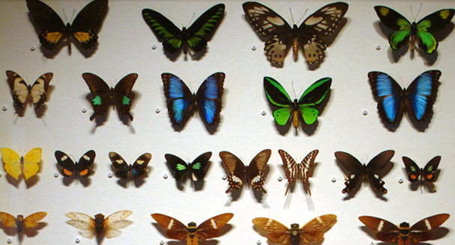
Collections Framework
Notes:
A collection is a generic term that refers to a container of objects.

Slide 18
Collections Framework
List
Set
Map
…

Slide 19
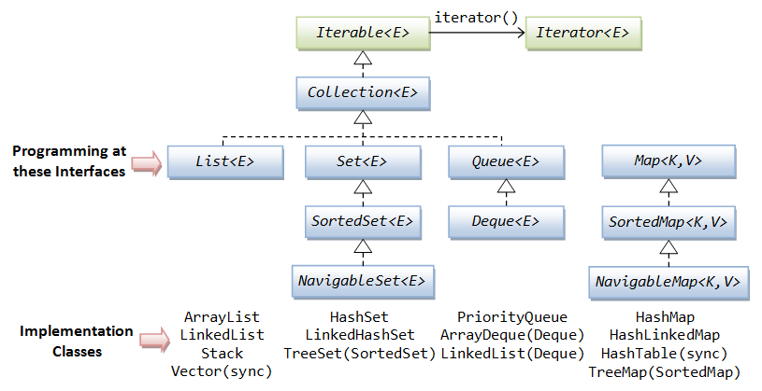
Collections Framework

Slide 20
Iterator vs Iterable
interface Iterator<E> { boolean hasNext(); E next(); void remove();
void forEachRemaining(Consumer<? super E> action); }
interface Iterable<T> { Iterator iterator();
void forEach(Consumer<? super T> action)
Spliterator<T> spliterator()
}

Slide 21
Collection
int size(); boolean isEmpty(); boolean contains(Object o);
boolean containsAll(Collection c);
Iterator<E> iterator(); boolean add(Object e);
boolean addAll(Collection c); boolean remove(Object o);
boolean removeIf(Predicate<? super E> filter)
boolean retainAll(Collection<?> c);
Object[] toArray();
…

Slide 22
List
Can not contain primitives
Kind of auto-resizable array
Ordered
Allows duplicate entries
ArrayList, LinkedList

Slide 23
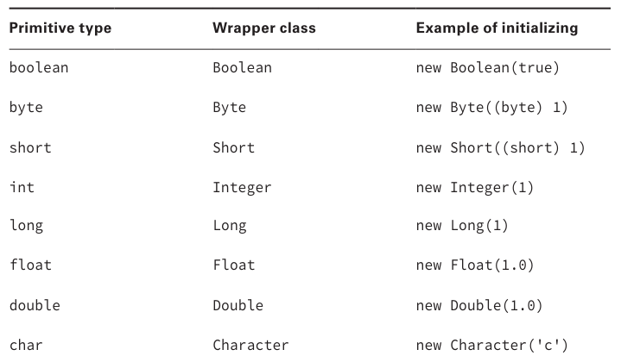
Wrappers

Slide 24
ArrayList
List<String> lessons = new ArrayList<>(); lessons.add("Intro"); lessons.add("OOP"); lessons.add("Collections"); print("All: " + lessons); // [Intro, OOP, Collections] print("Total count: " + lessons.size()); // Total count: 3 print("Last: " + lessons.get(lessons.size() - 1)); // Last: Collections
lessons.remove("OOP"); print("All except removed OOP: " + lessons); // [Intro, Collections]

Slide 25
ArrayList vs array
String[] stringsArray = new String[]{"Intro", "OOP", "Collections"};
List<String> stringsArrayList = new ArrayList<>();
stringsArrayList.add("Intro");
stringsArrayList.add("OOP");
stringsArrayList.add("Collections"); print(stringsArray); // [Ljava.lang.String;@6474c2 print(stringsArrayList); // [Intro, OOP, Collections]
stringsArrayList.remove("OOP");

Slide 26
LinkedList
LinkedList<Integer> linkedList = new LinkedList<>(); linkedList.addFirst(2); // 2 linkedList.addLast(3); // 2 3 linkedList.offerFirst(1); // 1 2 3 linkedList.offerLast(4); // 1 2 3 4 linkedList.add(5); // 1 2 3 4 5 linkedList.remove(3); // 1 2 3 5 (remove by index) linkedList.remove(Integer.valueOf(3)); // 1 2 5 (remove by value) linkedList.removeFirst(); // 2 5 linkedList.removeLast(); // 2 linkedList.indexOf(2); // index = 0

Slide 27
Collection iteration
Collection<Integer> list = List.of(1, 2, 3, 4, 5);
for (int index = 0; index < list.size(); index++) { System.out.println(list.get(index)); }
1
≈2≈3≈4≈5
Iterator iterator = list.iterator(); while (iterator.hasNext()) { System.out.println(iterator.next()); }
for (Integer element: list) { System.out.println(element); }
list.forEach(item -> { System.out.println(item); });
list.forEach(System.out::println);

Slide 28
Generic collections
List names = new ArrayList(); // Java 1+
List<String> names = new ArrayList<String>(); // Java 5+
List<String> names = new ArrayList<>(); // Java 7+
var names = new ArrayList<String>(); // Java 10+

Slide 29
Homework
Clean Code: A Handbook of Agile Software Craftsmanship by Robert C. Martin : Chapter 1-3
Update user action history implementation to exploit List instead of plain array;
Add ability to clean history;
Add ability to remove last element from history;
Add ability to encode/decode sentences consisting of multiple words;

Slide 30
Links
Generics
Collections
Cheat sheet

Slide 31
Thanks!
Any Questions?
Or find us in Slack:
@Yaroslav Brahinets
@Vasya Rudas
@Oleksandr Kucher

